Slide 1
Meet the teacher
Welcome to Year 3
Mrs Robinson (Monday – Wednesday)
Mr Johnston (Thursday and Friday)
Mrs Mc Combie Yr 3 Teaching Assistant

Slide 2
Classroom rules and routines
▶ School day timings - 8:45 – 3:15pm- Entrance Lowlands Avenue. Gate closes at 8.45 After 9am a child will be marked as late.
▶ Children's bags and belongings will be kept in lockers
▶ Medication- If your child has an inhaler, please send into school. Epi pens – speak to me.
▶ Medication must be handed in at the office
Alleriges – Nut free school
▶ Core Subjects in the morning Reading, Handwriting, English, Maths, R.E
▶ Afternoon teaching is PE, Computing, Science , Geography and History and PSHE and Music
▶ Under Parent Planners in Year 3 on the webpage is the Autumn 1 Parent Planner.
▶ Pencil cases are optional and should be labelled to avoid loss of items.
▶ Sensible water bottles need to be filled up to the top a- sensible bottles please.
▶ Snacks for morning break due to later lunch- healthy please (no fruit provided)

Slide 3
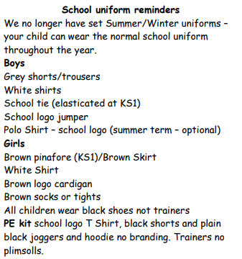
Uniform
Hair cuts – fashion haircuts not appropriate for school.
No earrings on P.E
days please.
Please note change in tights.

Slide 4
Classwork
▶ We will aim to encourage Independence and Resilience
▶ Learn Its challenges will be given once a week
▶ Times table practice in preparation for Year 4 will be done once a week
▶ Spelling tests on Monday- list under Homework on webpage. If your child is struggling, please come and speak to us.
▶ Assessment weeks – three times a year

Slide 5
Homework
▶ Spellings
Learn Its
▶ Reading journals- we will hand these out on Thursday, please hand in by following Thursday
▶ Reading at home
▶ Other homework may be given- homework page (History/Geography and Purple Mash)

Slide 6
PE
▶PE days- Tuesday and Thursday
▶Come to school in your SCHOOL P.E kits
▶Please label KIT especially black hoodies

Slide 7
RE
▶ Tuesdays/ Wednesdays = School Mass Saturdays = children’s Mass
▶ Prayer services – to be done once a week.
Discerning Disciples – New RE curriculum

Slide 8
Reconciliation and First Holy Communion
▶ Reconciliation – during Advent – 9th December – 1:30pm
▶ There will be a meeting after the Autumn Half Term Holiday.
▶ Commitment Mass will be 12th September
▶ First Holy Communion –19th June 11am and 1pm

Slide 9
Communication
▶ ‘Headlines’ newsletter every week
▶ Website relevant information
▶ Email/ telephone- please copy and paste BOTH teachers in on every email so that the teacher who is in school can respond.
▶ We are both available at the gate for any immediate queries.
Admin questions and queries to Postbox

