Slide 1

Welcome to Year 2
Please inform me if somebody new will be collecting your child from school, so I am aware at dismissal.

Slide 2
Staff in Year 2
Mrs Regan– Class teacher
Mrs Benton– Teaching Assistant/ French teacher
Mrs Baker- Teaching Assistant/Art teacher
Mrs Swann – PE teacher

Slide 3
Attendance
Our register closes at 8:50am. Children arriving at the office after this time will be marked as late
All children benefit from regular attendance. Earlier start of day to access early morning tasks.
Dismissal time- KS1 playground at 3:20pm
Frequent absences impact on children’s learning and friendships. Please discuss any concerns, we are here to listen and help.

Slide 4
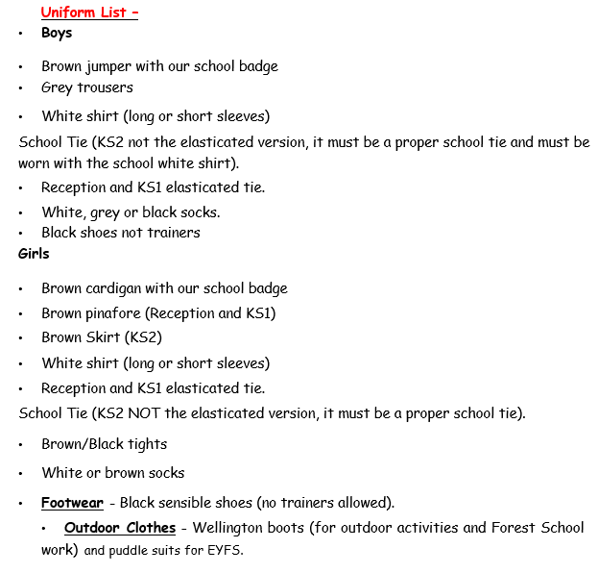
Uniform

Slide 5
Our P.E days are Monday and Thursday
Please ensure children arrive in their full St. Anne’s PE kit
Trainers for PE
White St. Anne’s logo t-shirt
Plain black shorts or tracksuit bottoms that don’t contain logos
Earrings need to be removed at home
Long hair needs to be tied up
Please label all items of clothing- especially jumpers and cardigans

Slide 6
KS1 Assessment
SATS are no longer completed at the end of Year 2
We are now using optional National Curriculum assessments to assess children at the end of the year
These are used in combination with termly Maths, Reading, Grammar and Spelling tests
At the end of the year, your child’s report will contain Teacher Assessment judgements for each subject.
Working Towards
Expected
Greater Depth

Slide 7
Homework
From next week, homework will be sent home on Fridays. Please return this by the following Friday. No homework will be set during school holidays.
Homework will usually be reading (1000 stories), Learn It’s and spellings practise. The children may also sometimes bring home a worksheet linked to the topic we have been focusing upon in Maths.
If you have any queries about homework, please email me.

Slide 8
Reading
Children’s school reading books will be changed on a weekly basis. Staff and reading volunteers in school will hear children read regularly.
Please ensure that an entry is made and signed by an adult each time your child reads at home. These comments help us to assess whether your child has a sound understanding of the book they have read and if their book needs to be changed.
You are also welcome to add comments about books your child is reading for enjoyment (e.g. library books).

Slide 9
Reading
We encourage all the children to participate in the 1,000 stories challenge. Like last year, the children can regularly select a book, discover the ‘Wow word!’ and enjoy reading with you at home. Certificates will be awarded and achievements celebrated in class.
Library visits take place termly throughout the year where children can select their own book to take home using their library card.

Slide 10
Spellings
A different spelling rule will be taught each week in class through our phonics lessons. Children will then be given spellings that follow this rule to practise at home.
All children receive 6 spellings to practise with a further 2 ‘challenge’ words.
These words are also practised daily through our handwriting.

Slide 11
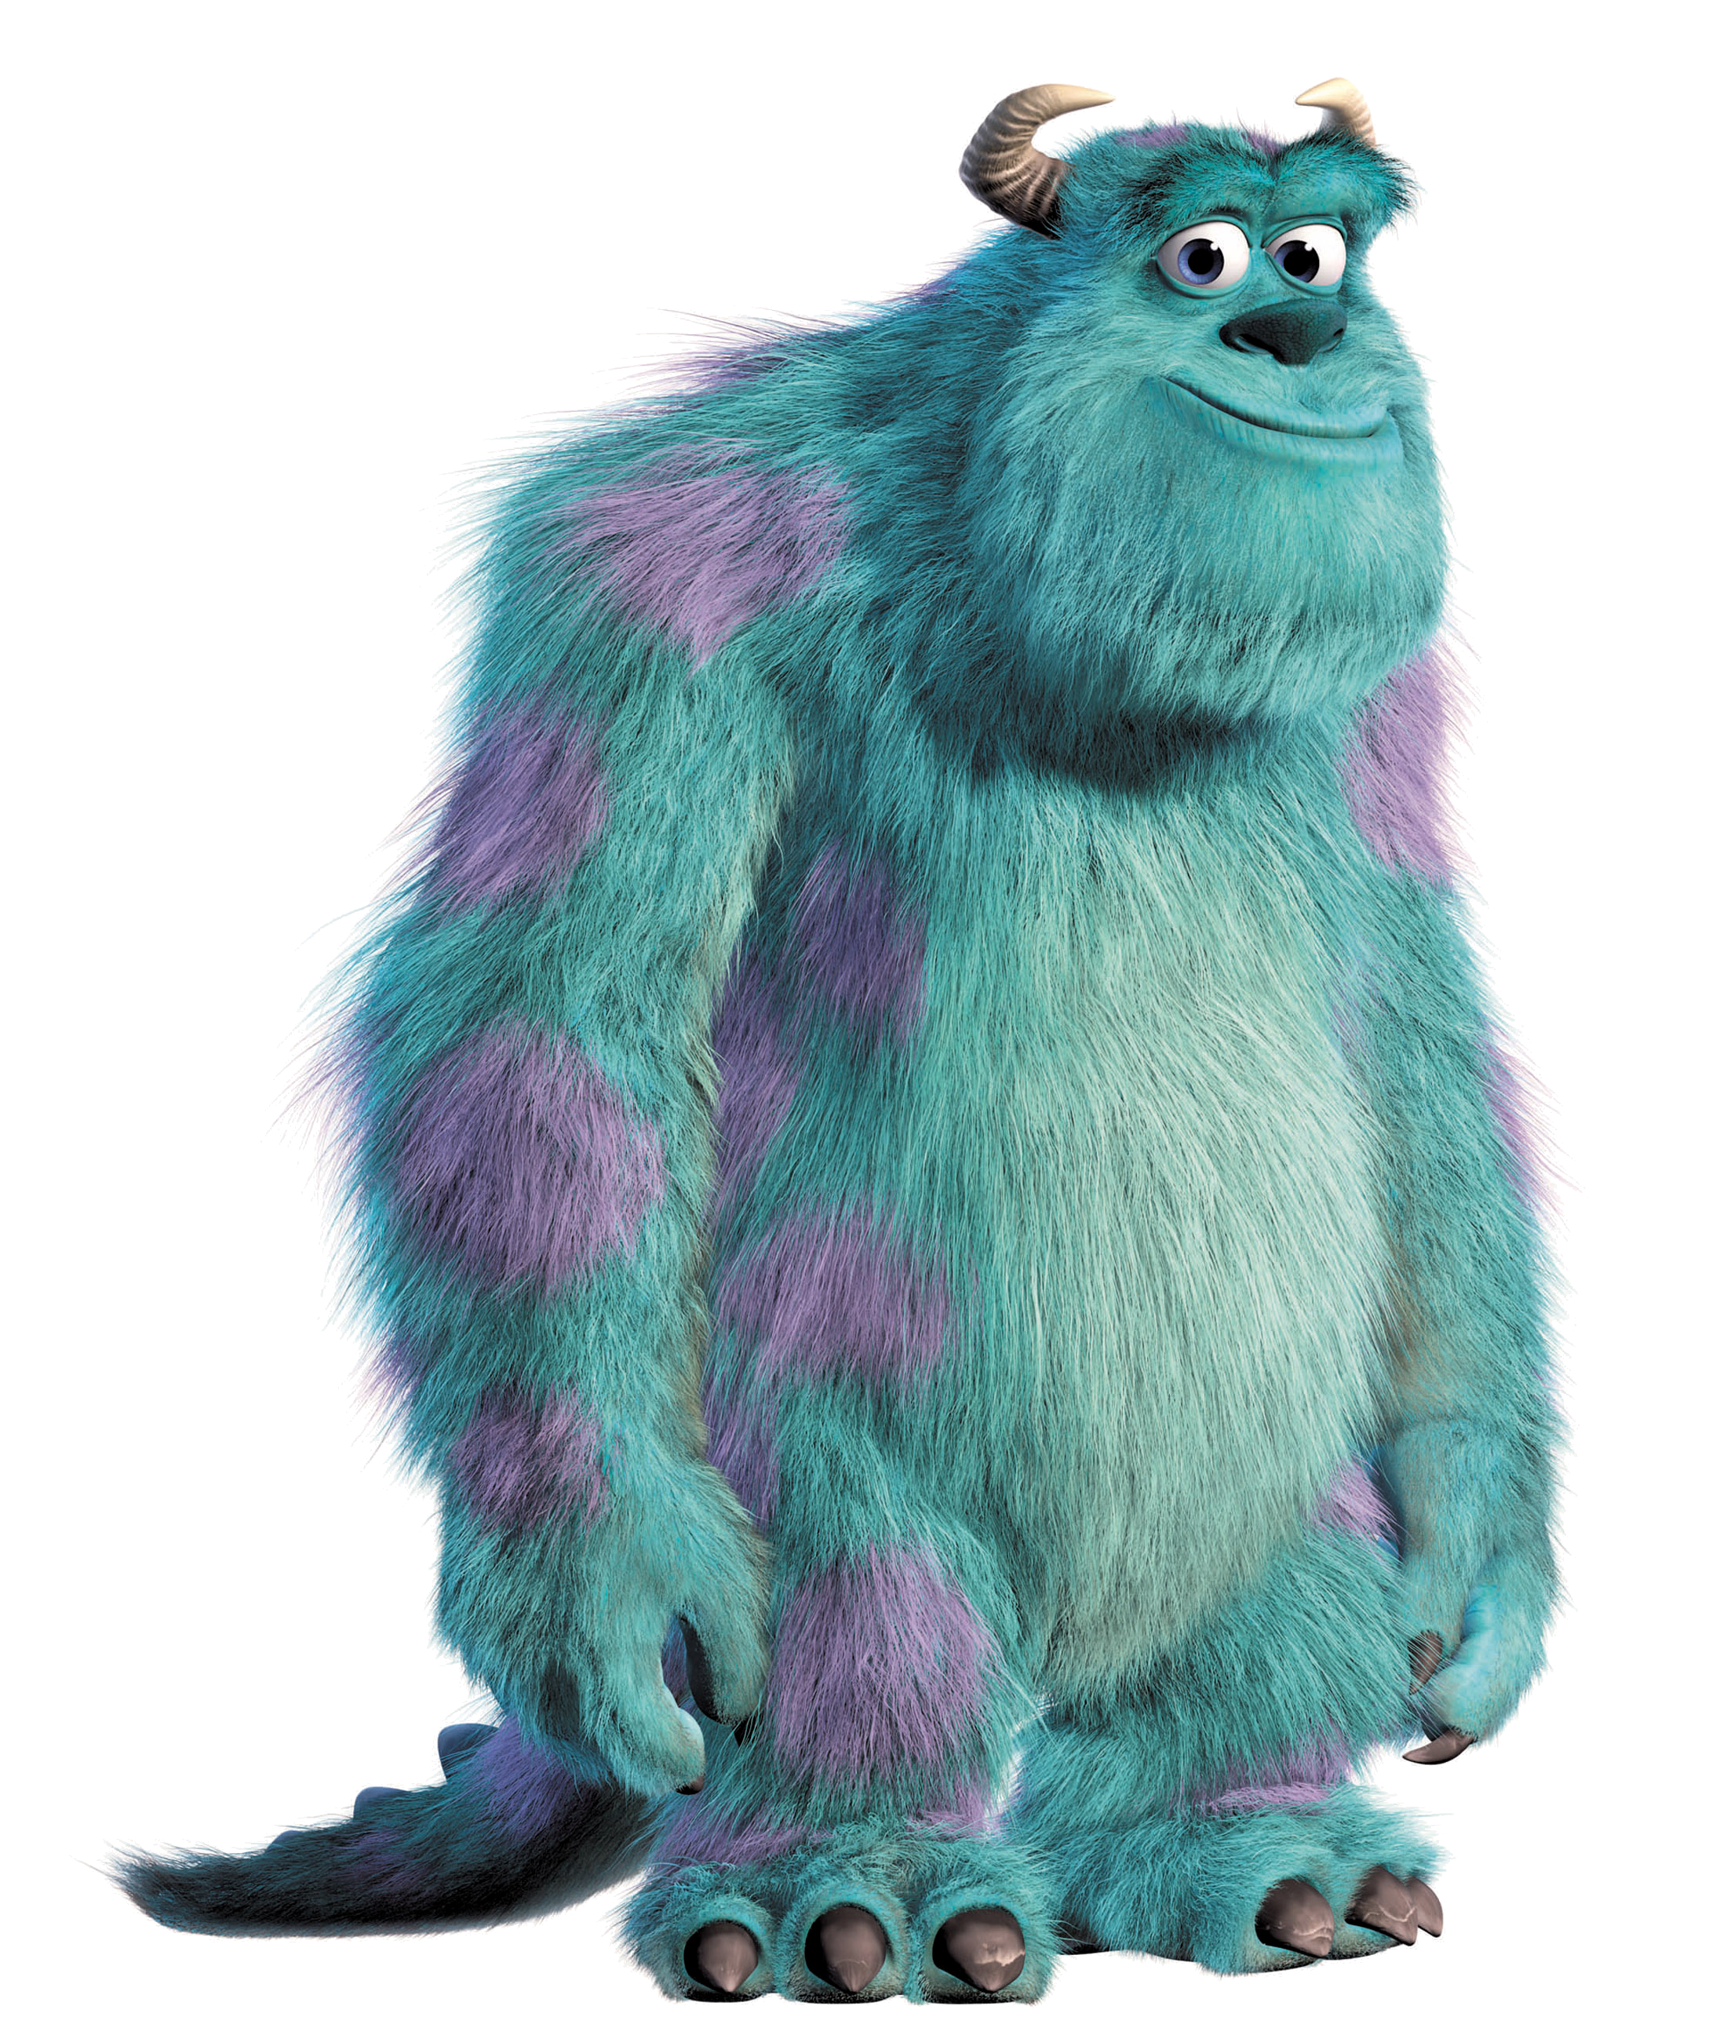
Rewards in Year 2
Space behaviour system- This records children’s achievements in class. Children receive stickers and will go into a raffle for a prize at the end of the day /week.
Class reward jar- Whole class behaviour is rewarded by adding marbles to our jar. Rewards (such as extra playtime or a visit to the park) are given once the children have reached their target.
House points- House points are given across school for a variety of positive reasons including great manners, hard work, teamwork and acts of kindness.
Sully- Each Friday, I will choose a member of the class to take Sully home. You can record photographs/ a message about what your child did over the weekend which they can share in class. Please return by the next Friday.

Slide 12
Parent Planners
Please check our class page to see an overview of what we are learning about in Year 2 each half-term.
You are also welcome to look at our subject knowledge organisers which give more detail about our Science and History/ Geography units of work.

Slide 13
Key dates for 2026
INSET day- Friday 2nd October (School closed)
School photographs- Monday 5th October
Y2/Y3 Family mass at Church- Saturday 17th October
Parent/Teacher meeting- Thursday 19th November
KS1 Nativity- Thursday 10th December @ 9:30am and Friday 11th December @ 2:00pm

Slide 14
Please check ‘Headlines’- School newsletter each week.
If you have any queries or concerns throughout the year, please feel free to email me at:
eregan@st-annes.walsall.sch.uk.
Thank you for listening.

