Slide 2
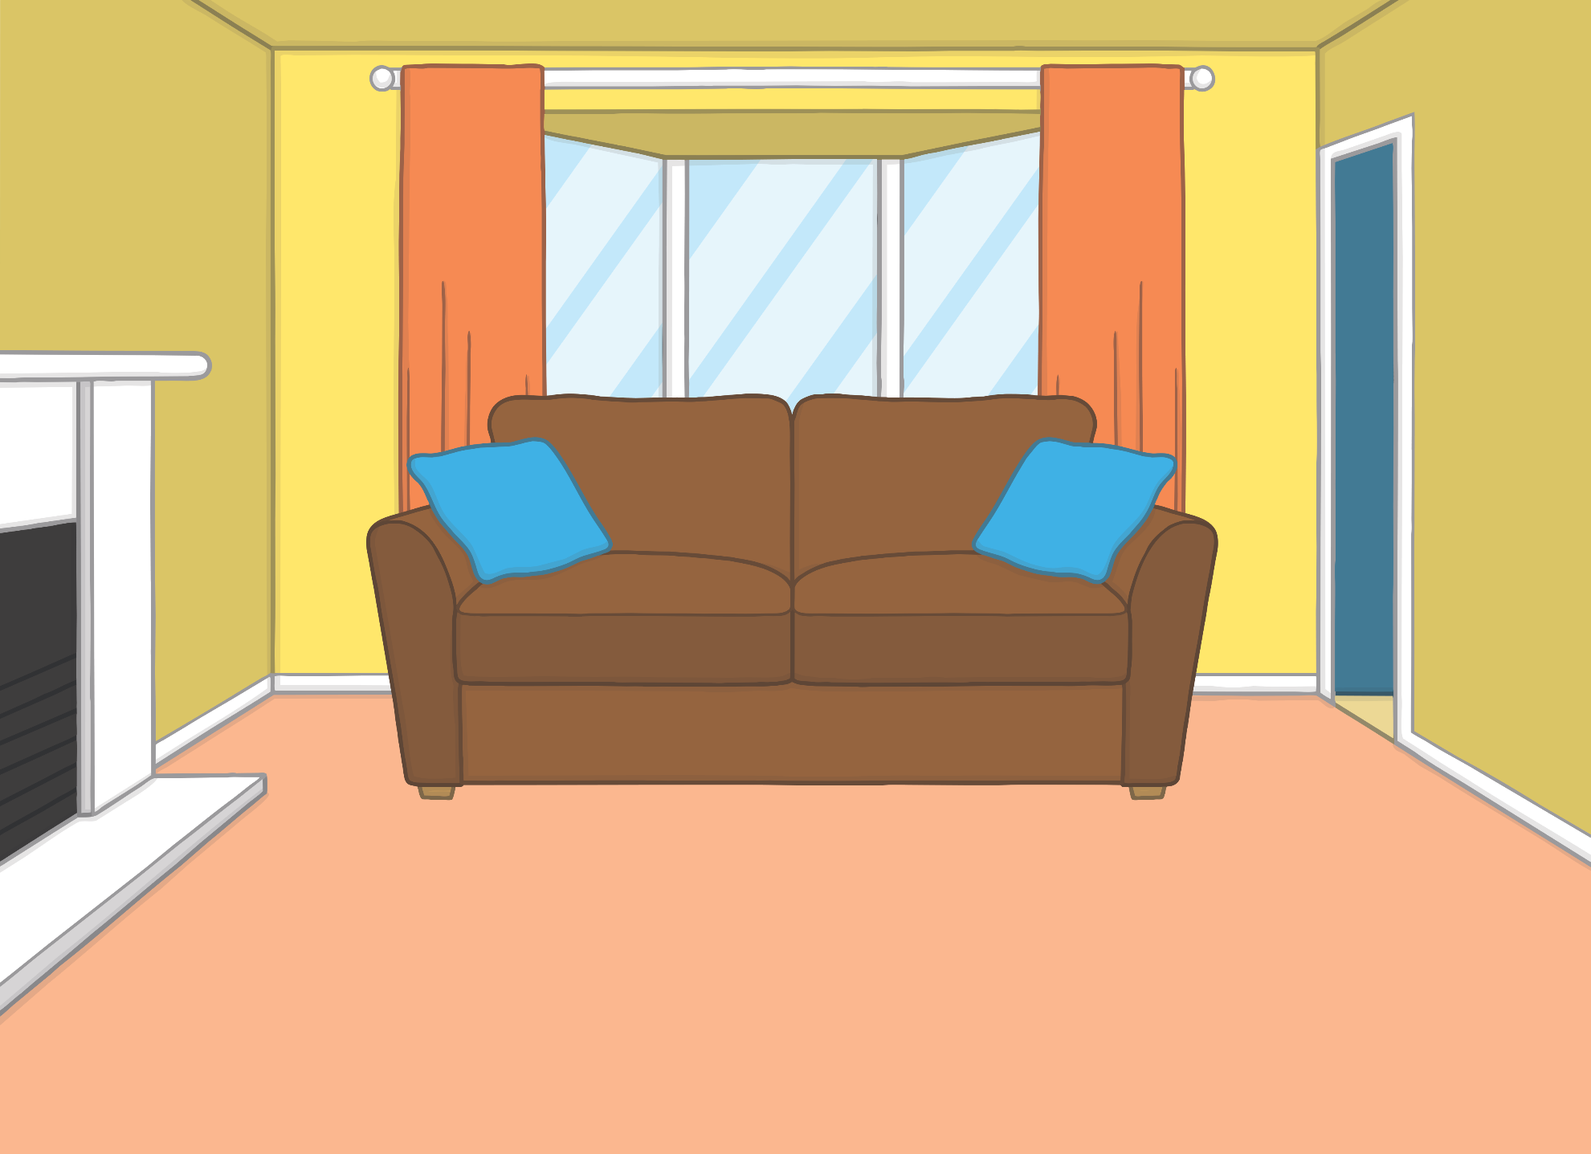


Hello, I’m Kit!
Hi, I’m Sam.
We are twins.

Slide 3
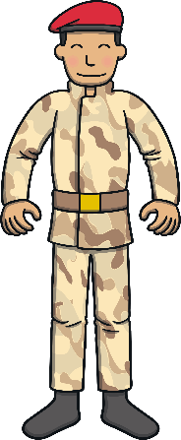
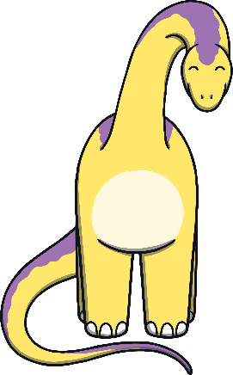





These are our toys.

Slide 4
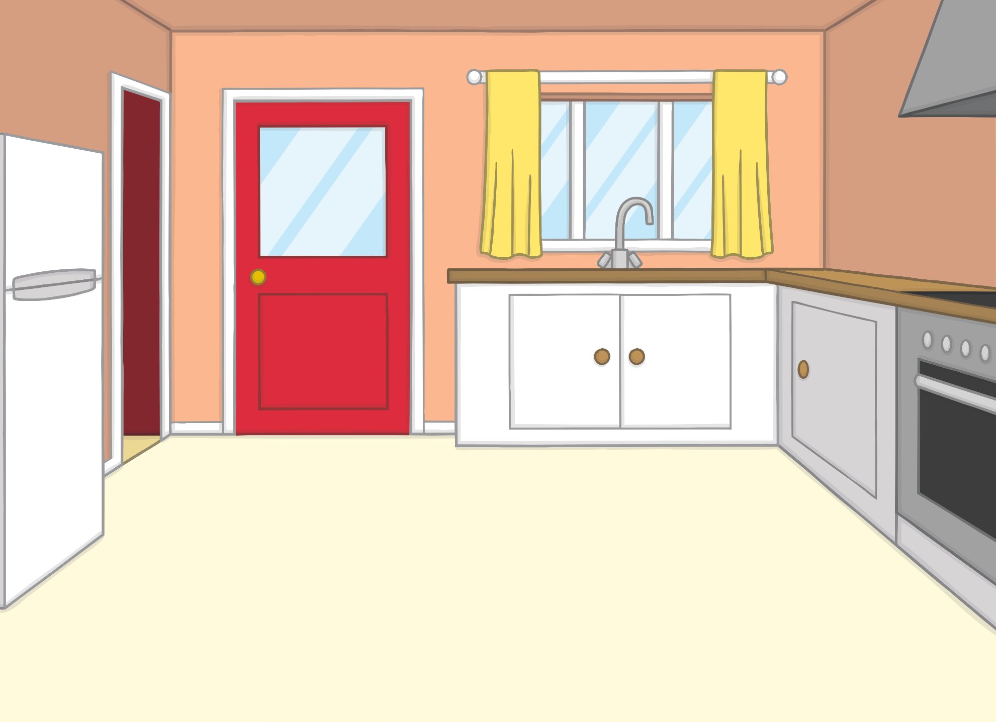

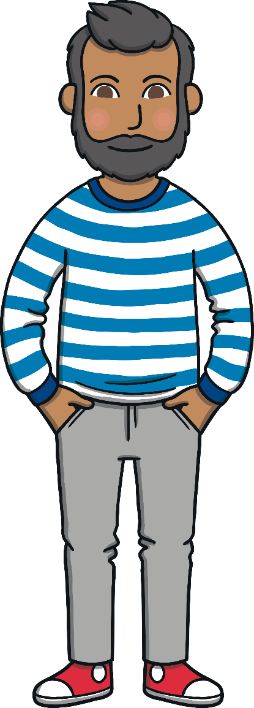
I’m Mum. I am an optician.
Hey! I’m Dad. I work in an office.

Slide 5

We are Gran and Grandad.
We live in the Scotland!

Slide 6
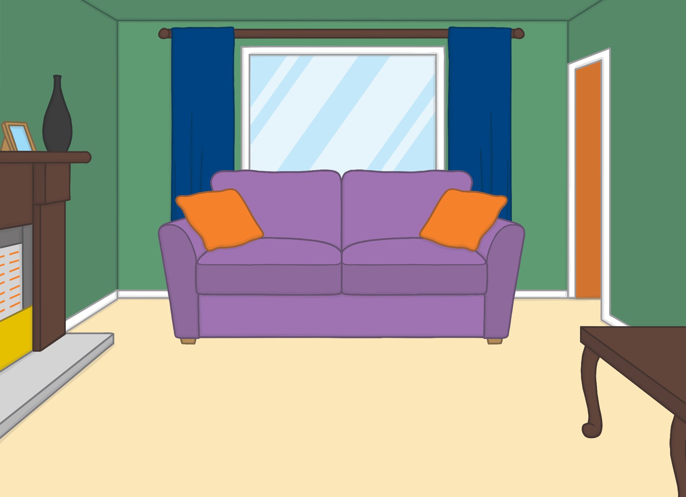
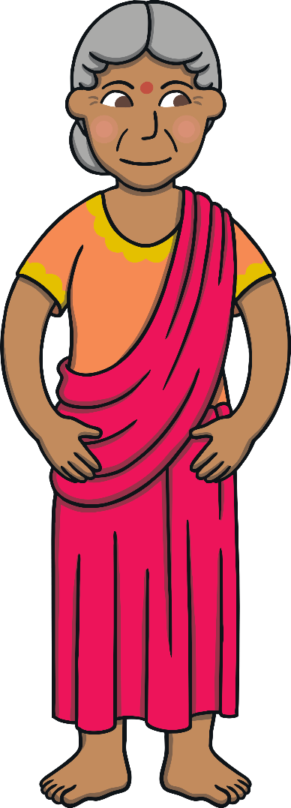

We are Grandma Dadi and Grandpa Dada.
We live in the city.

Slide 7
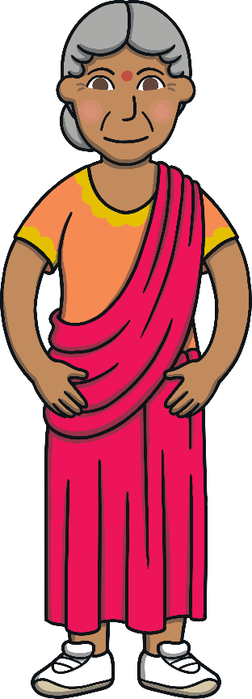






We are the Twinkl Phonics family!

